Slide 1
Continuous Deployment tool
Mahesh Veerabathiran
AWS Certified Developer Associate
AWS Certified Sysops Administrator Associate

Slide 2
Agenda
Stages of Transformation
High level design overview
Significant features
Big picture - CICD Pipeline
Prerequisites
Demo
Tool information

Slide 3
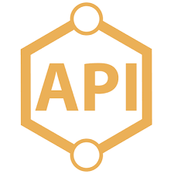




Stages of Transformation
Developing API and deploy services majorly using CFT and Chef since couple of years ago.

Slide 4
Stages of Transformation
Our initial pipeline uses following tools
Git – Used for Version controlling.
Jenkins – Runs code quality check and prepare artifacts for deployment
Uses Sonar for code quality validation.
Stores artifact in to Nexus.
Provision cloud infrastructure using Cloudformation.
Infrastructure configuration is handled by Chef.
Using chef, one can build reusable libraries for infrastructure configuration called Cookbooks.
Each cookbook can have more than one recipe.
Using Chef Role, one can define list of cookbook/recipe to be executed in order as per their requirement.
Chef Environment – Let you define any environment specific configuration for your requirement
Version of application artifact information is defined in chef environment artifacts

Slide 5
Stages of Transformation
Maintenance of multiple CFT’s and Chef artifacts though does not have major differences
1st API Stack
2nd API Stack
3rd API Stack
Cloudformation Templates
Cloudformation Templates
Cloudformation Templates
Chef Artifacts
(Role, Env.)
Chef Artifacts
(Role, Env.)
Chef Artifacts
(Role, Env.)

Slide 6
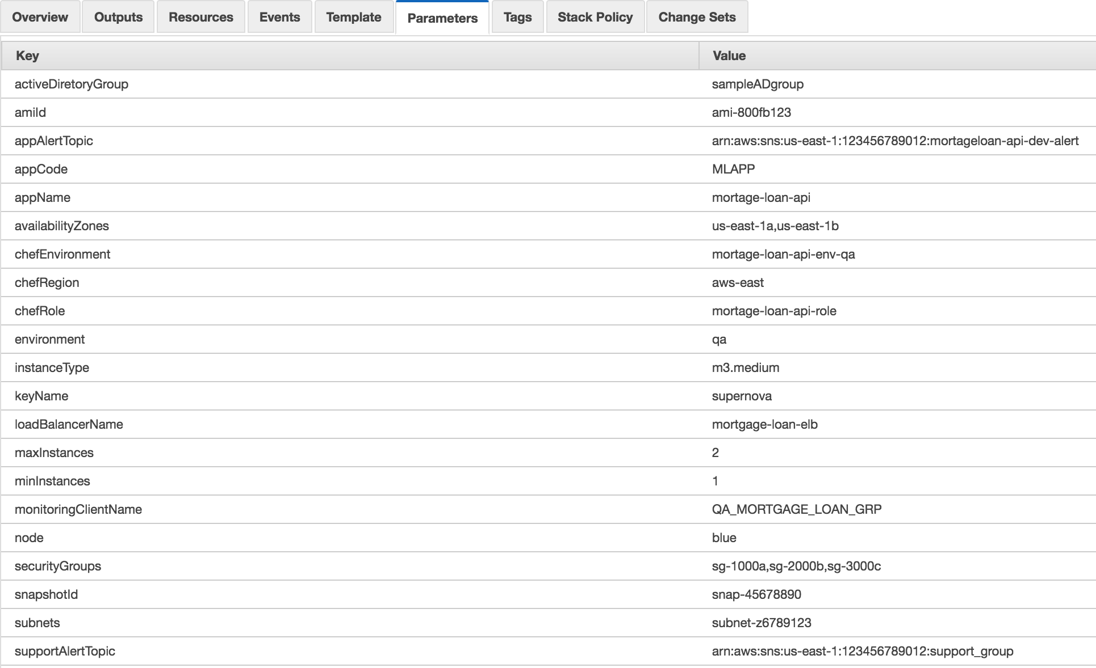
Stages of Transformation
Built Generic CFT’s to maintain one set of CFT templates for all our API’s

Slide 7
Stages of Transformation
But it did make our deployment complex, especially for Deployment team as deployment is still manual.
ASG
ELB

Slide 8
Stages of Transformation
Expanded our API footprint further in West region for high availability.
Enabled Blue/Green deployment for zero application downtime.
Ended up spending more hours in deployment.
ASG
ELB
2x
for Feature deployment
ASG
ELB
4x
for AMI rehydration

Slide 9

Stages of Transformation
It complicated further our deployment process. Also, It became difficult to get the release team availability.

Slide 10
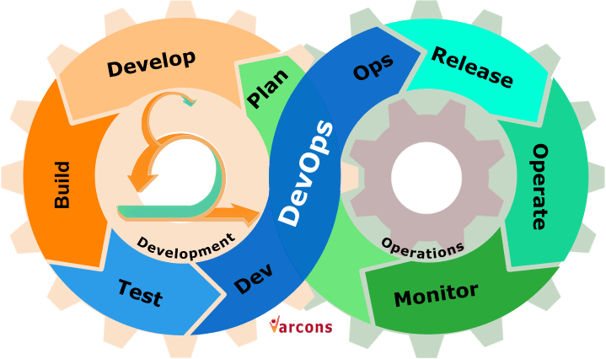
Stages of Transformation
Realized the need to automate our releases and looked for a solution to leverage automation solution using Chef and CFT’s

Slide 11


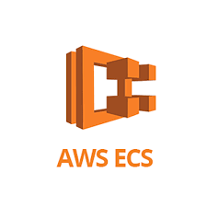
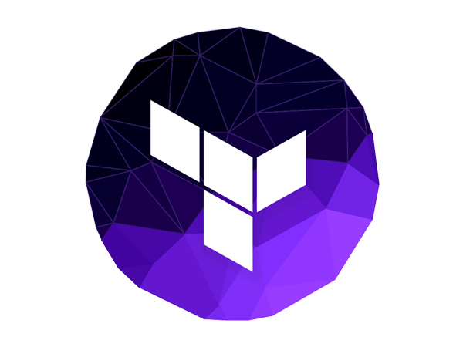
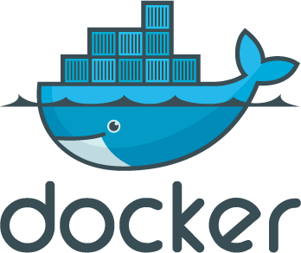
Stages of Transformation
All the available automation tools are based on Terraform, Docker etc. As our deadlines are narrow, could not spend time in new tools.
Expectation
EC2
vs
Reality
Terraform

Slide 12

Stages of Transformation
Hence started coding simple script for automation and it became Continuous deployment tool in a week time.

Slide 13
High level flow diagram

Slide 14
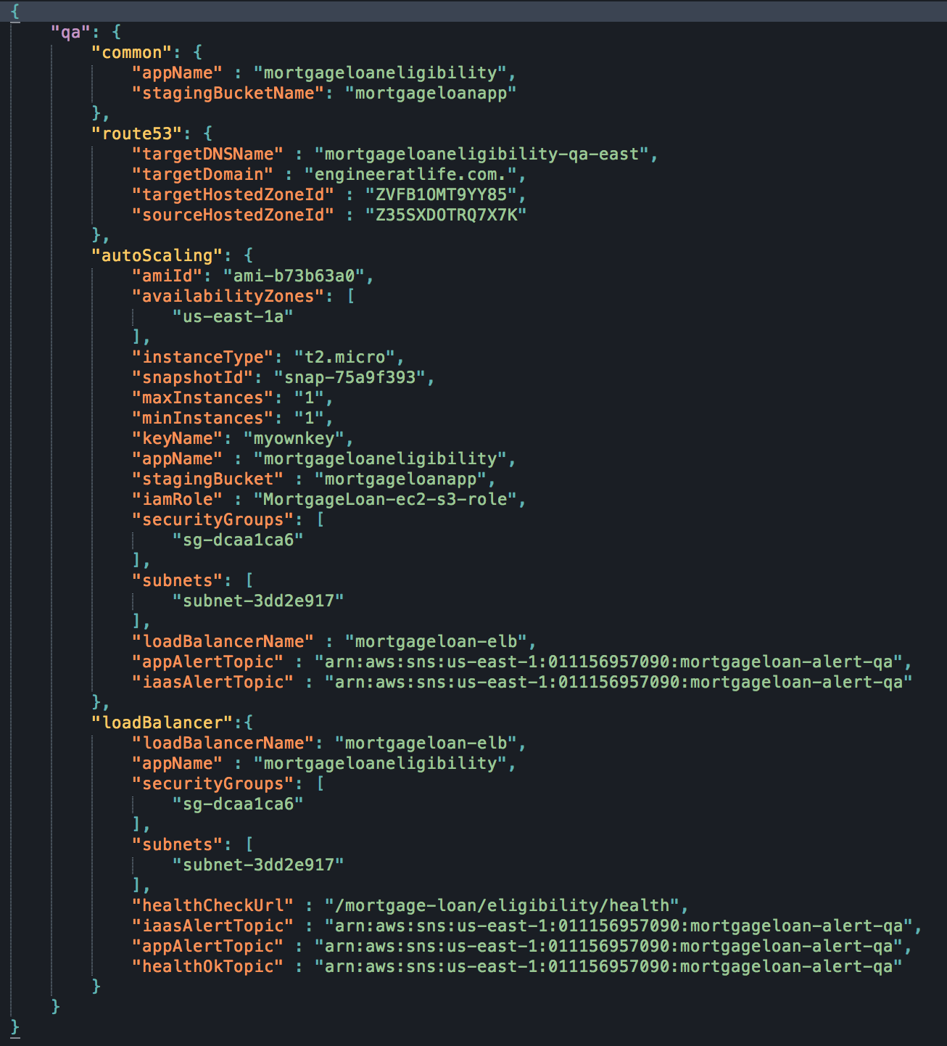
Config. file

Slide 15
Significant Features
All Cloudformation parameters are config. file driven

Slide 16
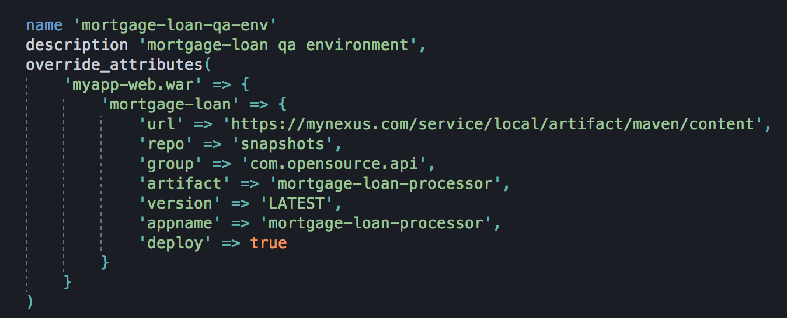
Significant Features
Artifact info. hardcoded in Chef Env.

Slide 17
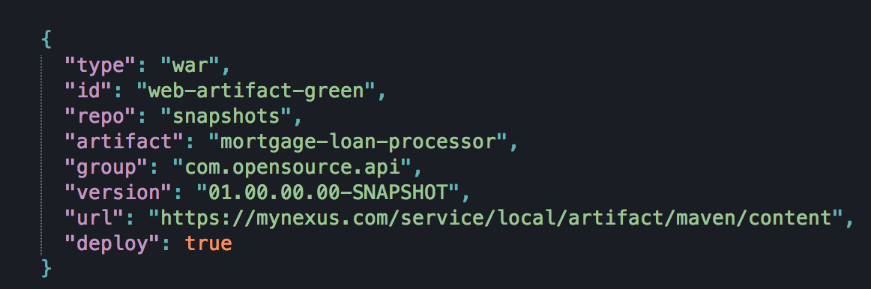
Significant Features
Now
API artifacts (*.war, *.jar) version are not hardcoded in CHEF.
Calls Nexus API to get latest artifact version & store artifacts info. in S3.
During Instance bootstrapping, pull down artifact info. from S3 and deploy the artifacts using custom cookbooks.
Therefore, it eliminates the need for maintaining chef artifacts one for blue and other for green.

Slide 18
Significant Features
Once the stack (blue/green) is created, the DNS recordset to create/update R53 is prepared and stored in S3.
Configure cloud watch to monitor ELB instance health and triggers SNS when at least one of the instance becomes healthy
One could write lambda which subscribes SNS event. When triggered, pull R53 update info. from S3 and update R53 DNS recordset to route traffic to new stack.

Slide 19
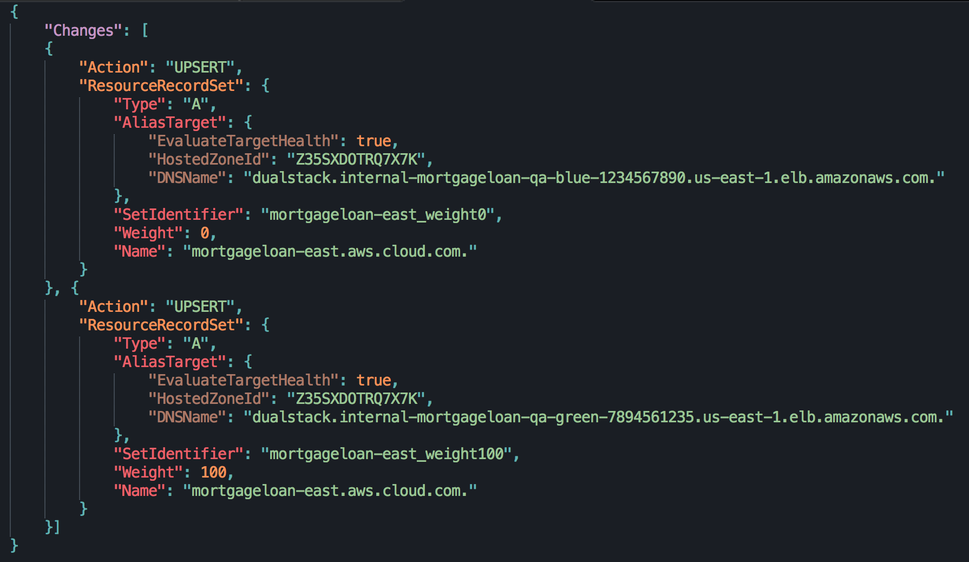
Significant Features
One could also trigger R53 update manually when application traffic is low using automation job.
Sample R53 update JSON file.

Slide 20
Significant features

Slide 21
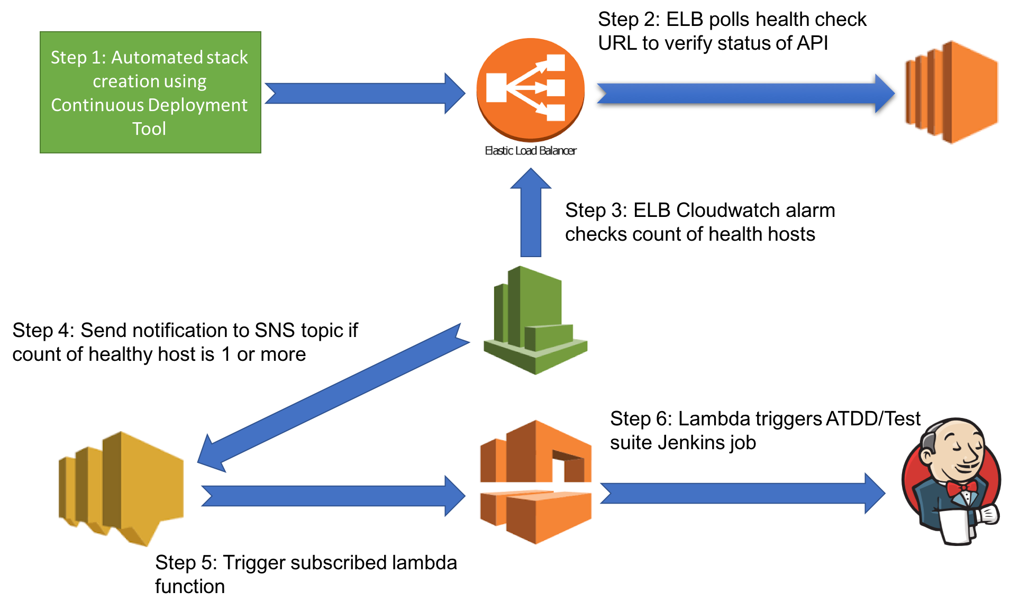
Big Picture - CICD Pipeline

Slide 22
Prerequisites
S3 bucket should be setup for staging temporary information
AWS System account & Access keys.
System account should have read/write permissions to your S3 bucket.
System account should also have following IAM policies enabled
iam:PassRole
route53:ListResourceRecordSets
route53:ChangeResourceRecordSets
Need IAM role to access your S3 bucket from EC2

Slide 23
Demo

Slide 24
Questions

Slide 25
Tool information
GitHub repo
Deck: https://github.com/dironman/continuousdeployment-meetup.git
Sample config: https://raw.githubusercontent.com/dironman/continuousdeployment-meetup/master/mortagage_loan_config.json
Contact me
https://www.linkedin.com/in/aboutmahesh

